Slide 1
Statistical Process Control System
SuperCEP Windows performs all analyzes, reports and charts required by Statistical Process Control.

Slide 2
Indispensable as part of any program to improve the quality of the products and services of your company
With SuperCEP Windows get statistical information required by customers to assess the quality of your products. It will also facilitate obtaining international quality certifications.

Slide 3
Top Tools of SuperCEP :
Capture, label and store sample data manually or automatically.
Process Capability Study.
Monitor variables and attributes of the process with Control charts.
Pareto chart for problem analysis.
Standard Acceptance Sampling.
Scatter diagram to study correlation between variables.
Production log.
Summary Reports of quality indexes.
Quality Certificates.

Slide 4
General Characteristics of SuperCEP :
Graphical environment very easy to use.
Ongoing training and user support.
High volume data storage.
Import and export data.
Settable usage levels and operator data access.
Connectivity with lab and process measurement equipment.
Operates on any PC with Windows.
Shares information over networks.
Prints with high resolution black and white or color.
Operation and Charts in English and 6 more languages.
Modular growth and corporate licenses.
Version updates at low cost.
Supported by international standards.

Slide 5
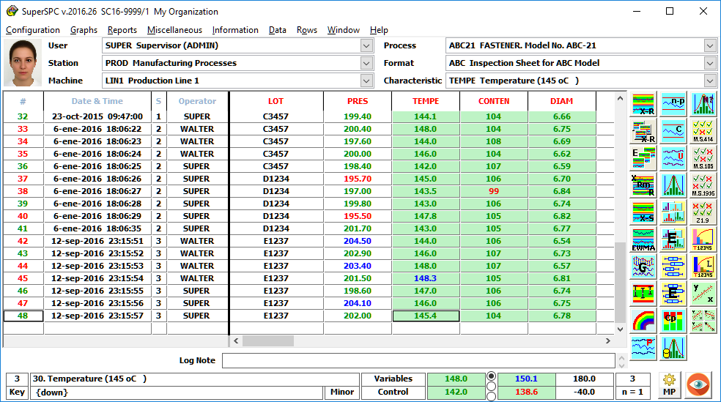
Through Inspection Spreadsheets quality data samples are captured, tagged, sorted and stored.

Slide 6
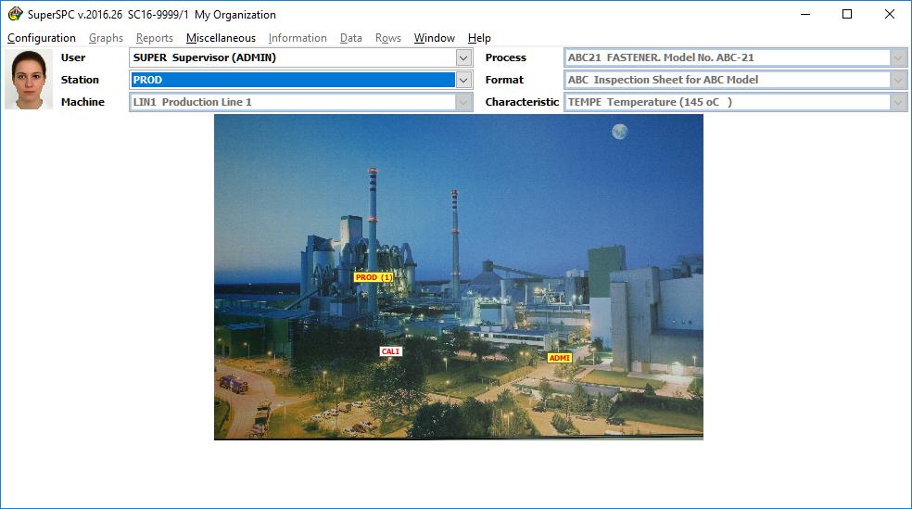
The entrance to each sheet is granted to users according to their level of access and specific need. In this way the data integrity is protected and the system operation is facilitated.
In the header of each sheet its identification is displayed:
* User. * Station or Department. * Machine, Line or Area.
The codes and names of these elements are fully configurable.

Slide 7
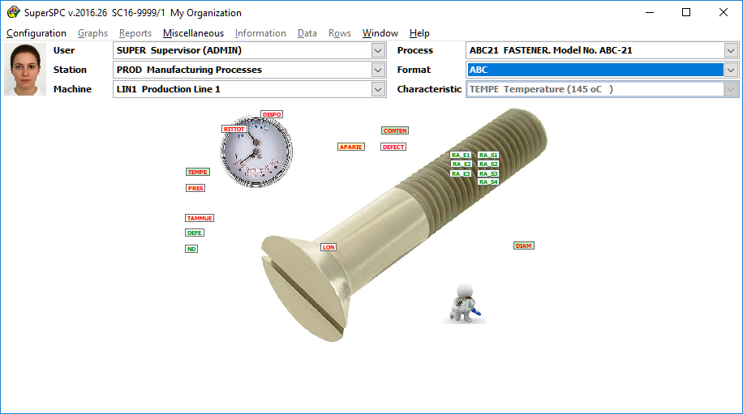
* Product, Process or Service.
* Inspection Format.
The codes and names of these elements are fully configurable.

Slide 8
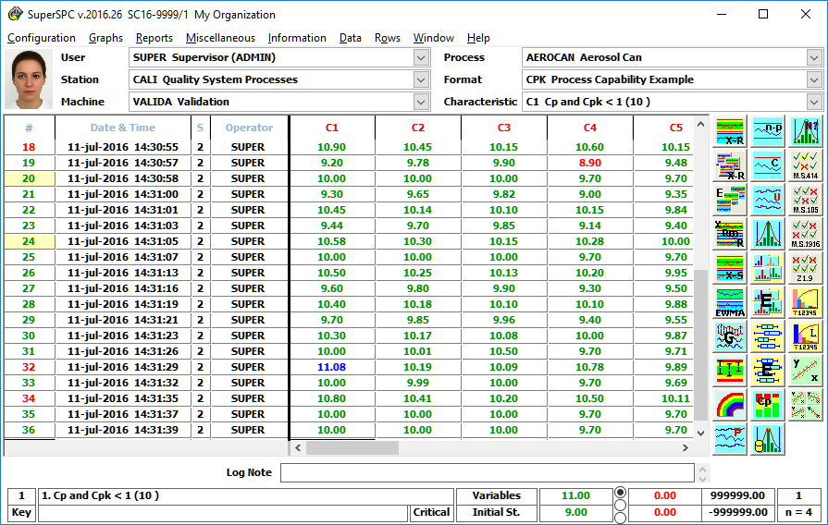
At the inspection sheet each row represents a sample automatically tagged with:
* Number. * Date and Time. * Production Shift. * Operator / Inspector.
Each column of the inspection sheet represents a variable or attribute control characteristic.
The sheet accepts variable data, attributes, free IDs, date-time and calculated values.
These data can be modified by authorized users
You can define from 1 to 250 columns per sheet. At the footer, the most important characteristic properties are shown as the cursor is placed on each column.

Slide 9
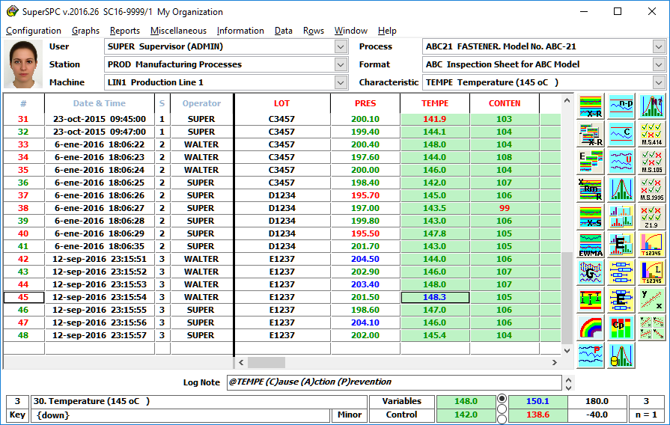
In the menu bar you have direct access to the editing, import, export, configuration and report options
Data out of specification are clearly indicated. Faulty or improperly captured data are automatically deleted.
You can attach a comment to each sample to conform the process log.
Target value, specification and control limits, mode of capture and sample size are clearly shown among other important data.

Slide 10
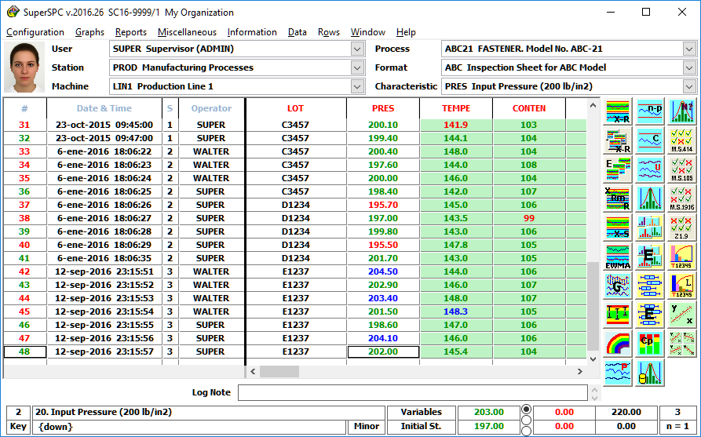
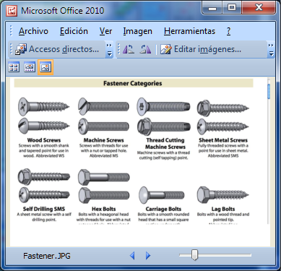
On the right side a charts bar is available to each user according to their level of analysis and decision power.
At any time you can request specific information about each quality characteristic such as formulations, operating conditions, preparation routines and equipment setup, inspection methods, etc.

Slide 11
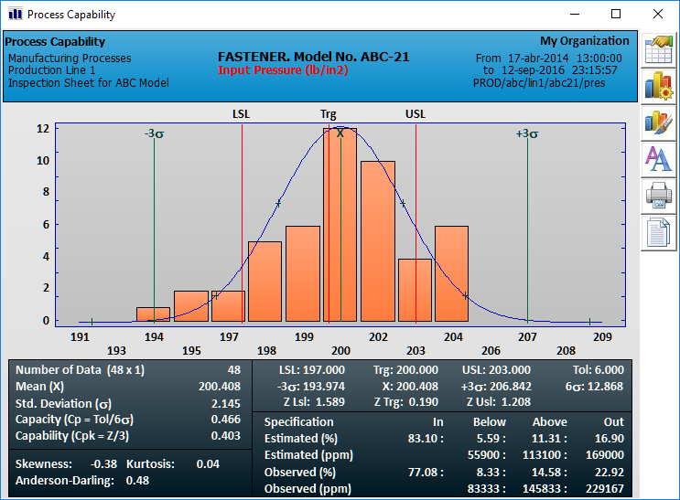
The fully automatic header identifies the source of the study data.
With the capability study, SuperCEP lets you know if your process is capable of meeting the specifications and tolerances required by the customer.
These studies are based on statistical theories of Normal and Non-Normal frequency distributions.

Slide 12
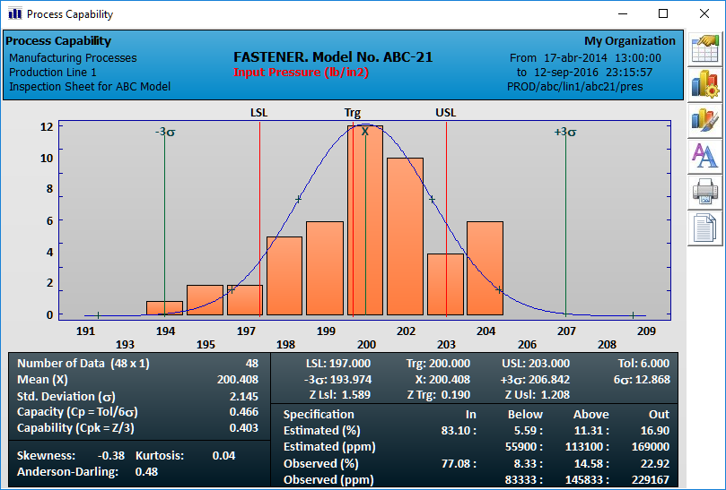
In the graphic panel you find: * Histogram showing scales for frequencies and class marks. * Indicators of the mean, standard deviation and specification limits. * Theoretical normal curve.
Tool buttons to:
Export the study to another program.
Reconfigure the parameters and scope.
Change colors and fonts.
Print the study.
In the numerical section you see: * Mean and standard deviation. * Tolerance variability and potential capacity Cp. * Capability Z’s and Process Cpk. * Bias, kurtosis and normality analysis. * Nonconforming observed and estimation for the population

Slide 13
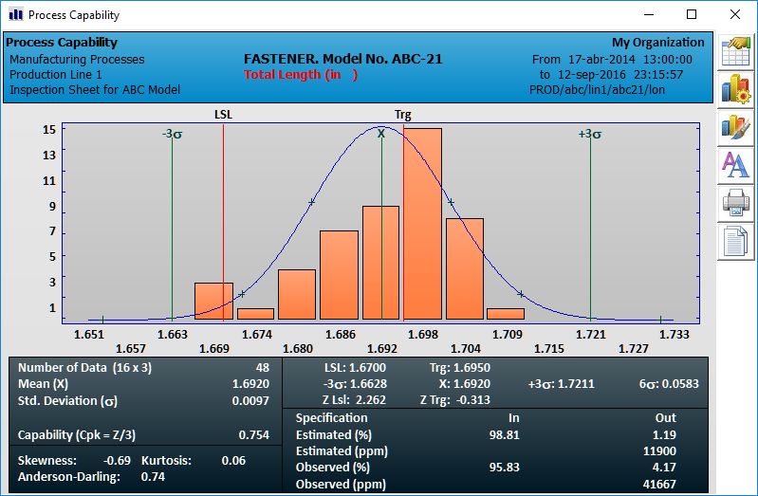
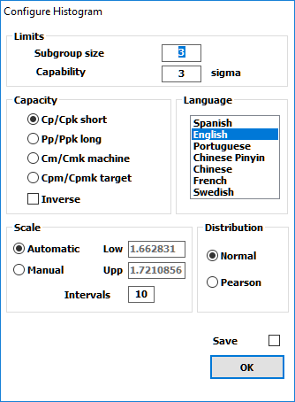
Within the configuration options you will vary: * Start and end date. * Number of intervals. * Confidence level 1-6 s. * Data Filter. * Normal or not Normal analysis. * Language of presentation.

Slide 14
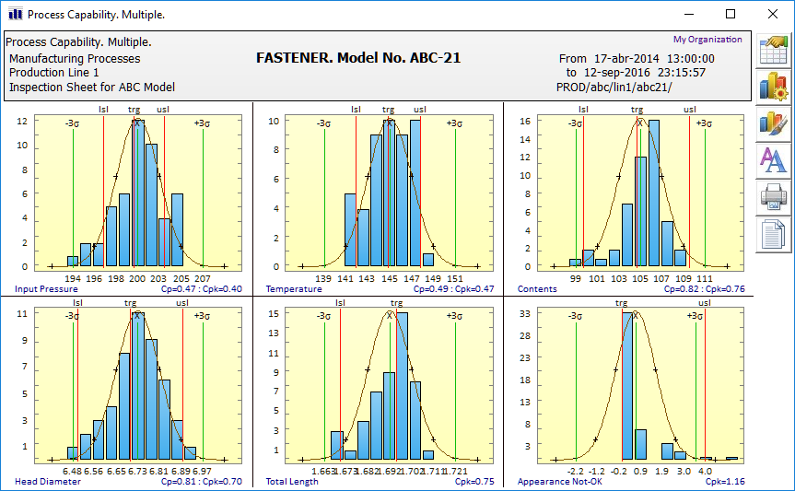
Collective histograms can be easily obtained to simultaneously analyze all quality characteristics in a single screen. This way you will quickly appreciate what variable or attribute requires greater attention.

Slide 15
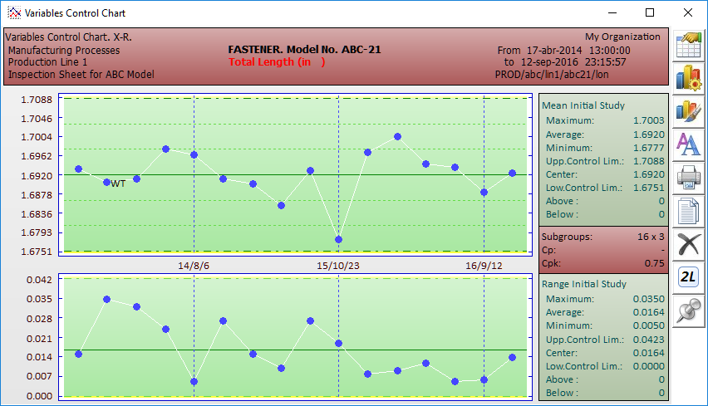
The fully automatic header identifies the source of the chart data.
The statistical technique of the Control chart allows you to monitor a stable process to determine when intervention is justified to correct a likely cause of process variation.
It is also used to show statistical evidence of good stability or process control.
You can choose between four variants:
X-R or Means and Ranges.
X-S or Means and Std Deviations.
IP-mR or Individuals and Moving Ranges.
EWMA-R or Exponentially Weighted Moving Averages and Ranges.
Any of these can be obtained as initial study or with preset control limits.

Slide 16
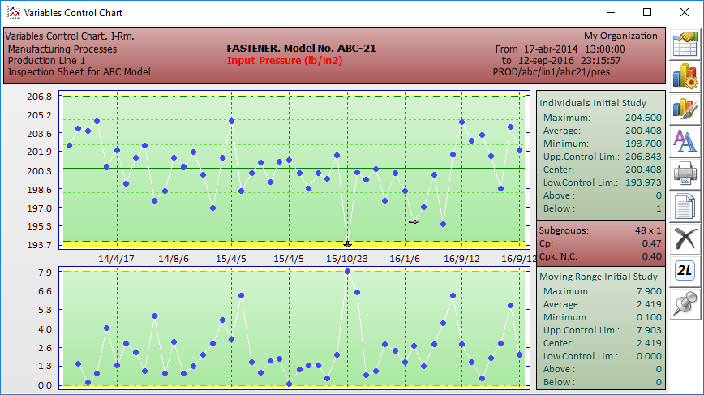
In the graphic section you will have one point for each sample or for each subgroup. You can also include comments by the corresponding point.
The horizontal scale can be configured to display the measurement number, the date and time or other characteristic of the sample.
The vertical scale is automatic.
Specification and control limits are shown. Also probability zones for +/- 1 and 2 sigmas.

Slide 17
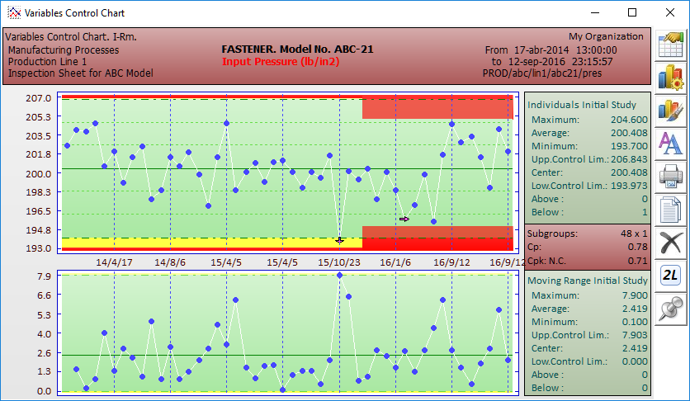
You can calculate and store Control multi-Limits reflecting changes in the process
The system clearly presents the calculated values of Control Limits, Mean, Range, maximum, minimum, etc.
By the buttons bar you can:
Export the chart to another software.
Configure the parameters and scope.
Print the graph.
Change colors and fonts.

Slide 18
SuperCEP does for you the detection of trends and statistical runs out of control, presenting alarms and messages with corrective actions.

Slide 19
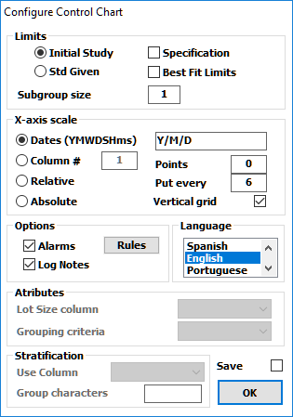
Within the configuration options you can modify:
Start and end dates.
Subgroup size.
Type of scales and limits.
Data filters.
Enabling Alarms and comments log.
English Language or 6 others.

Slide 20
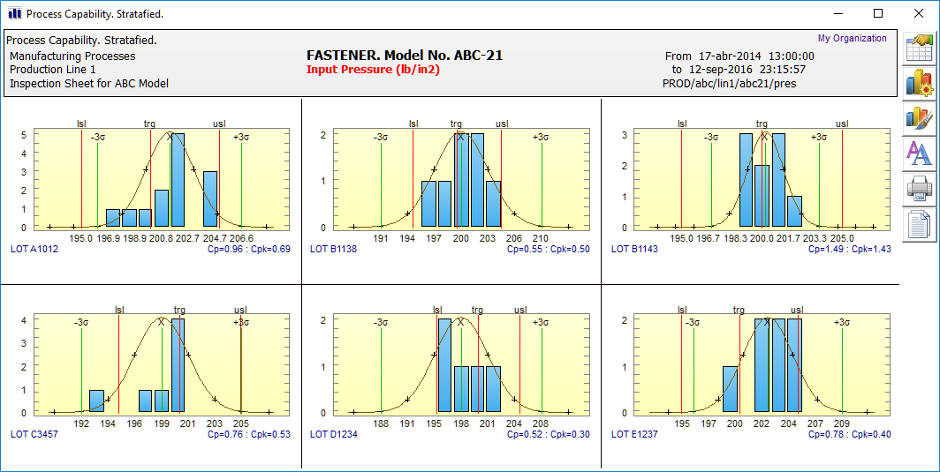
The great power of SuperCEP is demonstrated with the option of stratification and data filtering, whereby you can choose to analyze a subset of data that meets a particular criteria. For example the data of a shift, an operator or a lot, those in a range of values, etc.

Slide 21
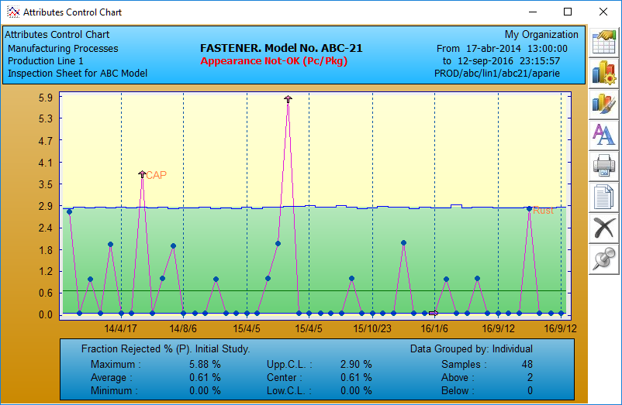
Control Charts for Attributes
In the graphic panel you will see one point for each sample or per area of opportunity. You can also include comments by the corresponding point.
You can get all control charts for attributes :
p Chart (defective fraction)
n-p Chart (defectives)
c Chart (defects)
u Chart (defects per unit)

Slide 22
This is a type P or defective fraction chart, in which, as in other attributes charts, all calculated values are displayed
With the buttons bar you can :
Export the chart to another application.
Configure the parameters and scope.
Filter eccentrics
Change colors and fonts.
Print the chart.
Control limits can be calculated or given.
As in the charts for variables, the horizontal scale is fully configurable.

Slide 23
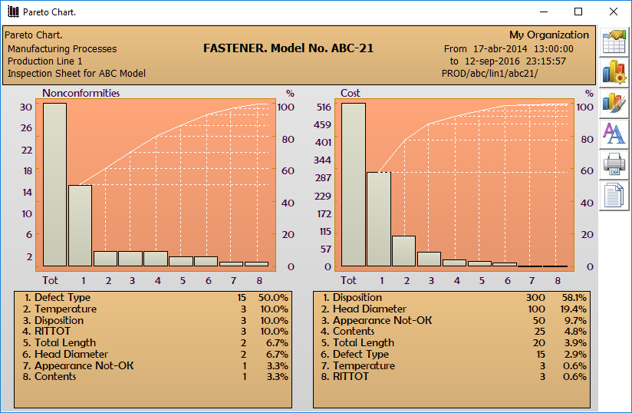
The cost per defect is determined for each characteristic and the relative frequency and its impact is clearly indicated.
As in the other SuperCEP charts, you can analyze any period you want.
Additionally you can build a Free Pareto, just capturing the defect code and the number of defects found.
The Pareto chart is a tool that allows you to rank the importance of quality problems depending on how often they appear and the cost or relative impact of each of them.
They are obtained in 2 ways: * By frequency of defects. * By cost of defects.

Slide 24
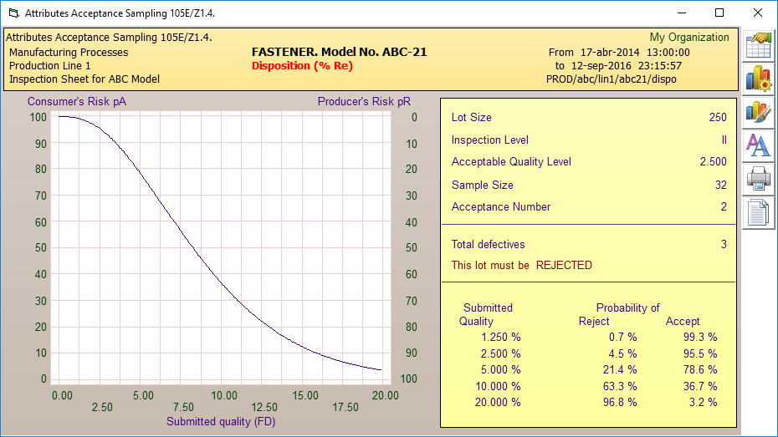
Acceptance sampling by attributes is a statistical technique that will allow you to take consistent decisions to accept or reject batches of materials inspected by attributes.
You have two options :
Military Standard 105E.
Military Standard 1916.
After definition of the sampling plan, SuperCEP calculates the sample size and the plan’s risk according to the characteristic operation curve OC.
After registering the inspection results you may accept or reject the lot.

Slide 25
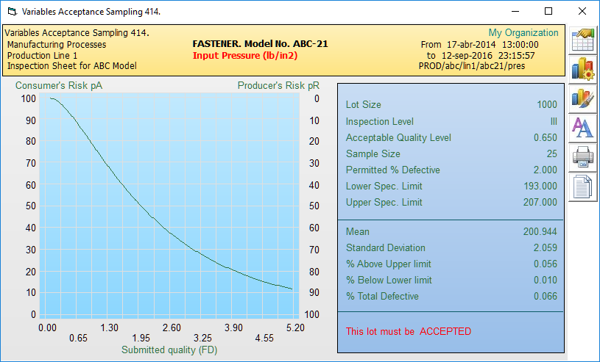
Acceptance sampling by variables is a statistical technique that will allow you to take consistent decisions to accept or reject batches of materials inspected by variables.
You have two options :
Military Standard 414
Military Standard 1916
With a sampling plan defined, SuperCEP calculates the sample size and risk of the method according to the OC operation curve.
Once the results of the inspection are registered you can accept or reject the lot

Slide 26
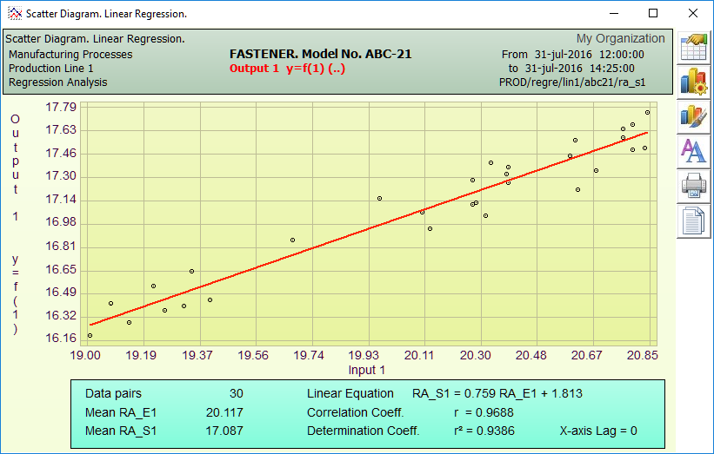
The scatterplot shows the relationship or dependency between two variables. It is necessary to investigate these relationships to predict variations indirectly caused.
The correlation coefficient validates the hypothesis of a dependency. The equation of the line will predict the dependent values.
Data can be transformed to nonlinear to increase the power of this analysis

Slide 27
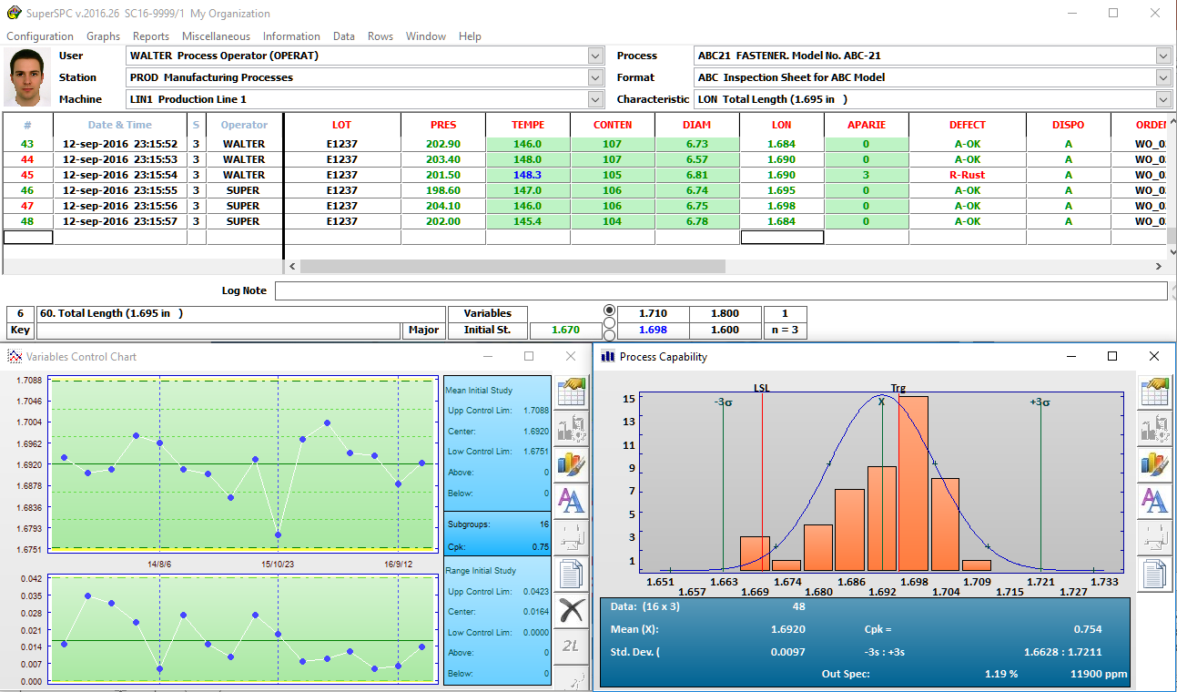
It is only necessary to input the datum and the chart instantly updates. If the data reaches the system directly from a sensor or instrument, the operator’s only concern is verifying his graphs to ensure that the process remains under statistical control
It has been shown that to obtain the maximum benefit from the Statistical Process Control techniques it should be brought as close as possible to the process itself. Under this concept operators would be responsible for monitoring the process with the control chart taking immediate decisions based on scientific, objective and uniform criteria.
SuperCEP 2016 is the ideal system to achieve the above mentioned, because it has a simplified mode of operation in real time that can generate the necessary information with minimal intervention from the operator

Slide 28
Counseling and Support If you already bought or are just evaluating any of our products, enjoy the free technical support we offer by email: soporte@supercep.com.mx Attention: Ing. José Luis Oviedo V. Phones : (55) 5445-5390 to 92 in Mexico City If you want personal attention we can meet you at your quarters or visit us at : Citilcún #381 Héroes de Padierna Tlalpan México 14200 D.F.

